Slide 1

AFAN OROMO
PROGRAMMING
LANGUAGE (AOBL)
A Beginner-First Programming Language with Local-Language Keywords
Reducing English Syntax Barriers for New Programmers
Afan Oromo Beginner Language Project

Slide 2

Contents
01
Introduction
Vision, architecture, and design philosophy
02
Language Reference
Keywords, types, and natural syntax forms
03
Writing AOBL Code
Practical code examples and patterns
04
Project Deep Dive
Architecture, decisions, and future roadmap

Slide 3

01
Introduction
Understanding the vision, architecture, and design philosophy behind AOBL

Slide 4
What is AOBL?
A small, beginner-first programming language
AOBL at a Glance
Uses Afan Oromo keywords for accessibility
Source: .or files with Afan Oromo keywords
Target: .py valid Python 3 code
Approach: Structured AST-based compilation
Audience: First-time programmers
Mission: Programming in your native language
Translates to Python 3 (.py) through compilation
Learners reason in their familiar language
Indentation-based syntax like Python
Localized error messages in Afan Oromo

Slide 5
Compilation Pipeline
Structured compiler architecture from source to Python
.or source code
Lexer
Parser
Type Checker
Python Gen
Tokenization
AST Construction
Validation
Code Generation
.py Output
Key Points
Structured parsing — not simple text replacement
Uses Abstract Syntax Tree (AST) for correctness
Includes type checking for safety
Generates valid Python 3 syntax

Slide 6

02
Language Reference
Keywords, types, and natural syntax forms that make AOBL unique

Slide 7
Core Programming Keywords
Understanding the Afan Oromo keywords and their meanings
AOBL Keyword | Afan Oromo Meaning | Python Equivalent | Category
haa | "let" / "declare" | Variable declaration | Variables
yoo | "if" | if statement | Control Flow
yookaan | "otherwise" / "else" | else clause | Control Flow
yoo_tahe | "else if" | elif clause | Control Flow
hanga | "until" / "while" | while loop | Loops
irra | "from" | for loop start | Loops
keessa | "inside" / "in" | for ... in | Loops
hojii | "work" / "function" | def function | Functions
deebi'i | "return" / "give back" | return statement | Functions
maxxansi | "display" / "show" | print function | I/O

Slide 8
Logic, Control & Exception Keywords
Logic Operators
Control Flow
Exception Handling
AOBL | Meaning | Python
fi | and | and
yookiin | or | or
miti | not | not
AOBL | Meaning | Python
darbi | pass | pass
kuti | cut / break | break
itti_fufi | continue | continue
AOBL | Meaning | Python
yaali | try | try
qabsiisi | catch | except
dhuma | end | finally
Literals
Natural Language Forms
AOBL | Meaning | Python
dhugaa | true / truth | True
soba | false / lie | False
AOBL | Meaning | Usage
ta'e | it is | yoo (cond) ta'e
hin | not | yoo hin ta'in
ta'in | it is not | yoo hin ta'in

Slide 9
Type Annotations
Optional type annotations with Afan Oromo type names
AOBL Type | Meaning | Python | Example
lakkoofsa | number / count | int | Integer
lakkf | float / decimal | float | Decimal
barruu | text / letter | str | String
dhugaa | truth / reality | bool | Boolean
Type Safety Benefits
1. Catch type errors at compile time, not runtime
2. Improves code documentation and readability
3. Helps learners understand data types conceptually
4. Optional annotations — use when ready
5. Translates directly to Python type hints
Example Usage
haa age: lakkoofsa = 25
haa name: barruu = "Afan"
haa price: lakkf = 19.99
haa is_valid: dhugaa = dhugaa

Slide 10
Complete Keyword Reference
AOBL | Python | AOBL | Python
haa | Variable declaration | maxxansi | print
yoo | if | fi | and
yookaan | else | yookiin | or
yoo_tahe | elif | miti | not
hanga | while | darbi | pass
irra | for (start) | kuti | break
keessa | in | itti_fufi | continue
hojii | def | yaali | try
deebi'i | return | qabsiisi | except
lakkoofsa | int | dhuma | finally
lakkf | float | dhugaa | True
barruu | str | soba | False
ta'e | natural form | hin | natural form
ta'in | natural form

Slide 11
Beginner-Friendly Natural Syntax
AOBL supports natural language forms for conditionals
Standard Form
Benefits
yoo x > 5:
maxxansi("x is greater than 5")
yookaan:
maxxansi("x is not greater than 5")
Reduces intimidation for first-time learners
Uses familiar Afan Oromo phrases
Natural Form
ta'e = "if it is" — natural conditional
yoo (x > 5) ta'e:
maxxansi("x is greater than 5")
yoo hin ta'in:
maxxansi("x is not greater than 5")
hin ta'in = "if it is not" — negation

Slide 12
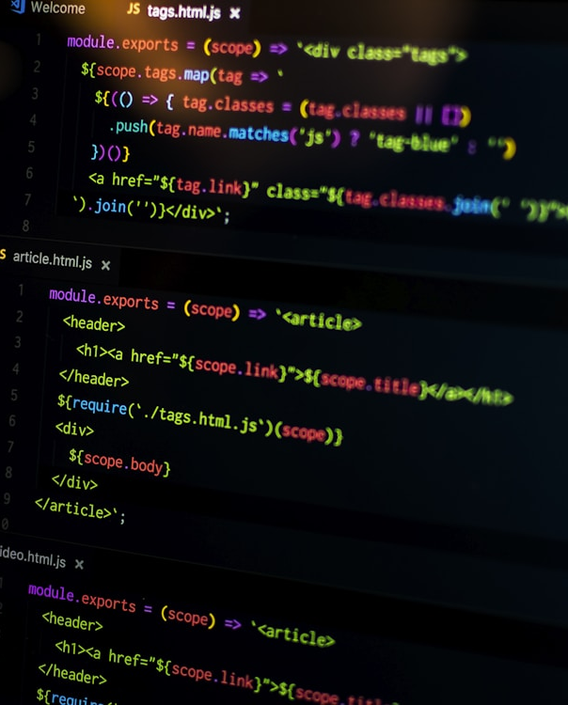
03
Writing AOBL Code
Practical code examples from variables to exception handling

Slide 13
Variables & Expressions
Variable Declaration
Boolean Logic
haa a = 10
haa b = 4
yoo x > 5 fi x < 10:
maxxansi("In range")
Arithmetic
Key Notes
maxxansi(a + b * 2)
haa declares variables — no type required
maxxansi outputs to console (like print)
yoo starts conditional blocks
fi = and, yookiin = or, miti = not
Indentation defines code blocks
Comparison
yoo x > 5:
maxxansi("Greater")

Slide 14
Loops & Conditionals
While Loop
For Loop
If-Else
haa x = 0
hanga x < 4:
maxxansi(x)
x = x + 1
irra item keessa [1, 2, 3]:
maxxansi(item)
yoo x == 2:
maxxansi(99)
yookaan:
maxxansi(x)
Generated Python
# While loop
x = 0
while x < 4:
print(x)
x = x + 1
# For loop
for item in [1, 2, 3]:
print(item)

Slide 15
Functions & Exception Handling
Basic Function
Try-Except-Finally
hojii ida(a, b):
deebi'i a + b
yaali:
maxxansi(risky_operation())
qabsiisi:
maxxansi("Error occurred")
dhuma:
maxxansi("Cleanup")
With Type Annotations
hojii ida(a: lakkoofsa, b: lakkoofsa) -> lakkoofsa:
deebi'i a + b
With Exception Variable
yaali:
maxxansi(risky_operation())
qabsiisi error:
maxxansi(error)
hojii = define a function
deebi'i = return a value
yaali/qabsiisi/dhuma = try/except/finally

Slide 16

04
Project Deep Dive
Architecture, design decisions, and the future of AOBL

Slide 17
Project Structure
Core Files
Documentation
translator.py — CLI entrypoint
afan_oromo_lang/lexer.py
Tokenization with indentation support
afan_oromo_lang/parser.py
Recursive descent parser
afan_oromo_lang/ast_nodes.py
AST model definitions
afan_oromo_lang/type_checker.py
Strong-typing validation
afan_oromo_lang/generator.py
Python code generation
docs/language_spec.md — Language specification
docs/short_report.md — Design decisions
Examples
examples/basic.or / basic.py / basic.out
examples/control_flow.or / .py / .out
examples/feature_demo.or / .py / .out
Each example includes the .or source file, generated .py output, and expected .out result for validation

Slide 18
Design Philosophy
Why Python as Target?
AOBL Design Philosophy
Indentation-based syntax aligns with teaching
Intentionally small grammar
High readability and simplicity
Local-language keywords reduce cognitive load
Maps 1:1 to common programming structures
Natural syntax forms reduce intimidation
Widely used and accessible
Structured translation (not text replacement)
Unicode support for identifiers and keywords
Mission: Enable programming education in native languages —
demonstrating that programming can be culturally adapted

Slide 19
Localized Error Messages
All error messages are in Afan Oromo for better comprehension
Example Errors
Dogoggora: faayilli hin argamne — Error: file not found
Dogoggora: tab hin eeyyamamu — Error: tabs not allowed, use spaces only
Dogoggora: indentation sirrii miti — Error: incorrect indentation
Dogoggora: type hin wal simne — Error: type mismatch
Dogoggora: gosa hin walsimu — Error: type not compatible
Benefits
Improves feedback clarity
Reduces language barrier in debugging
Consistent with language design

Slide 20
Features & How to Use
Core Language Features
Running the Translator
1. Variables and assignment
2. Arithmetic and boolean expressions
3. If/elif/else conditionals
4. While loops
5. For loops with irra ... keessa
6. Function definitions and return
7. Try/except/finally exception handling
8. List literals
9. Basic type annotations
10. Natural conditional forms (ta'e, hin ta'in)
11. Unicode identifiers and keywords
# Translate .or to .py
$ python translator.py examples/program.or
$ python examples/program.py
# Custom output path
$ python translator.py input.or -o output.py
Output
Milkaa'e: output.py
Shows progress through each stage:
Lexer → Parser → Type Checker → Generator

Slide 21
Translation Example
AOBL Source (basic.or)
Key Observations
haa a = 10
haa b = 4
maxxansi(a + b * 2)
haa becomes variable assignment
maxxansi becomes print
Operator precedence preserved
Generated Python (basic.py)
Valid Python syntax generated
Parentheses added for explicit precedence
a = 10
b = 4
print((a + (b * 2)))
The compiler preserves the semantic meaning of the original AOBL code while generating clean, idiomatic Python that follows PEP 8 conventions.
Output
18

Slide 22
Challenges & Future
Challenge 1: Natural Language Forms
Future Enhancements
Balancing natural language with deterministic parsing
Solution: Grammar supports both standard and natural forms
Language
More comprehensive type system
Classes and objects
Modules and imports
Advanced data structures
Tooling
IDE integration
Better error messages with line numbers
Debugging support
Interactive REPL
Community
More examples and tutorials
Video demonstrations
Challenge 2: Unicode Support
Supporting apostrophe-containing keywords (e.g., deebi'i)
Solution: Proper Unicode handling in lexer and parser
Challenge 3: Type Checking
Keeping type checker simple while catching mismatches
Solution: Strong-typing with basic type inference
Challenge 4: Indentation
Python-like indentation in source language
Solution: Custom indentation tracking in lexer

Slide 23
Summary
Key Takeaways
Impact
Reduces English syntax barriers for Afan Oromo speakers
1. Enables programming education in native language
2. Demonstrates that programming languages can be culturally adapted
3. Provides a foundation for other local-language programming tools
Structured compiler ensures correct translation
Local-language keywords improve accessibility
Natural syntax makes programming approachable
Generates valid, executable Python code
"Programming should be accessible in every language —
AOBL is a step toward that future."

Slide 24

Do you have
any questions?
Thank you for your attention.
Project: Afan Oromo Beginner Language (AOBL)
Docs: docs/language_spec.md
Examples: examples/ directory

